Slide 1

Analysis 1: Foundations of Modeling Lessons 4.1: Logic and deductive reasoning
Analysis Team, 2020/2021

Slide 2
Overview of this lesson: Logic and deductive reasoning
Propositional equivalences,
De Morgan’s laws,
Simplification rules – logical equivalences (optional)
Deductive reasoning,
Validity and soundness,
Rules of inference,

Slide 3
Overview of this lesson: Logic and deductive reasoning
Learning objectives:
Get acquainted with propositional equivalences and deductive reasoning,
Learn and apply simplification rules.
At the end of the lesson a student should be able to:
Determine the validity of a given argument.
Apply the knowledge to simplify conditional statements in programming.

Slide 4
Propositional equivalences

Slide 5


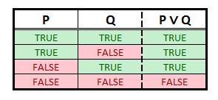
Tautology, contradiction, contingency
Tautology - a formula or assertion that is true in every possible interpretation (always TRUE)
P ∨ ~P ↔ T
Contradiction – is an unsatisfiable statement, both through negation or affirmation (always FALSE).
P ∧ ~P ↔ F
Contingency –a formula that is neither Tautology nor Contradiction.
P ∨ Q

Slide 6
De Morgan’s Laws for logical propositions
De Morgan's Laws describe how mathematical statements and concepts are related through their opposites.
In propositional logic, De Morgan's Laws relate conjunctions and disjunctions of propositions through negation.
In computer engineering, De Morgan's Laws are applicable for developing logic gates.

Slide 7
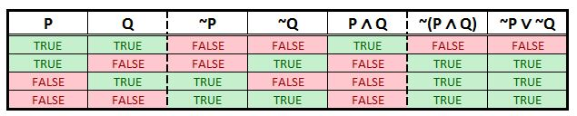
De Morgan’s Laws for logical propositions
Negation of the Conjunction of Propositions:
The negation of the conjunction of two propositions P and Q is equivalent to the disjunction of the negations of those propositions.
~(P ∧ Q) ↔ ~P ∨ ~Q

Slide 8
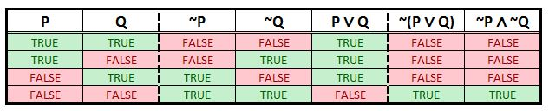
De Morgan’s Laws for logical propositions
Negation of the Disjunction of Propositions:
The negation of the disjunction of two propositions P and Q is equivalent to the conjunction of the negations of those propositions.
~(P ∨ Q) ↔ ~P ∧ ~Q

Slide 9
De Morgan’s Laws for logical propositions
Negation of the Conjunction of Propositions:
~(P ∧ Q) ↔ ~P ∨ ~Q
Exercise: Use De Morgan’s Law to negate the following statement:
R: I read slides AND I do homework.
P:
Q:
~R:
I read slides.
I do homework
Either I don’t read slides, or I don’t do homework

Slide 10
De Morgan’s Laws for logical propositions
Negation of the Disjunction of Propositions:
~(P ∨ Q) ↔ ~P ∧ ~Q
Exercise: Use De Morgan’s Law to transform the following sentence:
~R: It is not the case that my pet is dog or cat.
P:
Q:
R:
The pet is dog.
The pet is cat.
My pet is NOT a dog, and my pet is NOT a cat.
Same as: My pet is neither dog, nor cat.

Slide 11
Basic logical equivalences (optional)
Name of identity | Equivalence
1. Identity law | P ∧ True ↔ P P ∨ False ↔ P
2. Domination law | P ∧ False ↔ False P ∨ True ↔ True
3. Idempotent law | P ∧ P ↔ P P ∨ P ↔ P
4. Double negation law | ~(~P) ↔ P
5. Commutative law | P ∧ Q ↔ Q ∧ P P ∨ Q ↔ Q ∨ P
6. Associative law | (P ∧ Q) ∧ R ↔ P ∧ (Q ∧ R) (P ∨ Q) ∨ R ↔ P ∨ (Q ∨ R)
7. Distributive law | P ∧ (Q ∨ R) ↔ (P ∧ Q) ∨ (P ∧ R) P ∨ (Q ∧ R) ↔ (P ∨ Q) ∧ (P ∨ R)
Notes:
Students don’t have to learn these tables. However, they should bookmark it for future reference if needed.

Slide 12
Basic logical equivalences (optional)
Name of identity | Equivalence
8. De Morgan’s law | ~(P ∧ Q) ↔ ~P ∨ ~Q ~(P ∨ Q) ↔ ~P ∧ ~Q
9. Absorption law | P ∧ (P ∨ Q) ↔ P P ∨ (P ∧ Q) ↔ P
10. Negation law | P ∧ ~P ↔ False P ∨ ~P ↔ True

Slide 13
More logical equivalences (optional)
 | Equivalence
11. | P → Q ↔ ~P ∨ Q
12. | P → Q ↔ ~Q → ~P
13. | P ∧ Q ↔ ~(Q → ~P)
14. | (P → Q) ∧ (P → R) ↔ P → (Q ∧ R)
15. | (P → Q) ∨ (P → R) ↔ P → (Q ∨ R)
16. | (P → R) ∧ (Q → R) ↔ (P ∨ Q) → R
17. | (P → R) ∨ (Q → R) ↔ (P ∧ Q) → R

Slide 14
Even more logical equivalences (optional)
 | Equivalence
18. | P ↔ Q ↔ (P → Q) ∧ (Q → P)
19. | P ↔ Q ↔ ~P ↔ ~Q
20. | P ↔ Q ↔ (P ∧ Q) ∨ (~P ∧ ~Q)
21. | ~(P ↔ Q) ↔ P ↔ ~Q

Slide 15
Proving logical equivalences with truth tables – exercise (optional)
Task: select 2 logical equivalencies from 11 to 21. Then, prove them using truth tables.
Work in teams 2 – 3 students.
Time 10 minutes.

Slide 16
Applying logical equivalences: Simplifying logical expressions (opt.)
Simplify the following logical expression:
~(P ∨ (~P ∧ Q))
Step 1: De Morgan’s Law [#8] ~(P ∨ (~P ∧ Q)) ↔ ~P ∧ ~(~P ∧ Q))
Step 2: De Morgan’s Law [#8] ~P ∧ ~(~P ∧ Q)) ↔ ~P ∧ (~(~P) ∨ ~Q)
Step 3: Double negation [#4] ~P ∧ (~(~P) ∨ ~Q) ↔ ~P ∧ (P ∨ ~Q)
Step 4: Distributive law [#7] ~P ∧ (P ∨ ~Q) ↔ (~P ∧ P) ∨ (~P ∧ ~Q)
Step 5: Negation law [#10] (~P ∧ P) ∨ (~P ∧ ~Q) ↔ False ∨ (~P ∧ ~Q)
Step 6: Identity law [#1] False ∨ (~P ∧ ~Q) ↔ ~P ∧ ~Q
↔
~P ∧ ~Q

Slide 17
Laws: Applications
How to evaluate Python Boolean expressions

Slide 18
How can we apply laws in programming?
Expressions can be implemented in different ways.
Correct implementation is crucial.
Example: assume x and y are two variables
How can you rewrite these Boolean expressions?
not( x>= 0 )
not( y%2 == 0 )

Slide 19
How can we apply laws in programming?
Expressions can be implemented in different ways.
Correct implementation is crucial.
Example: assume x and y are two variables
How can you rewrite these Boolean expressions?
not( x>= 0 ) can be simply rewritten as x<0
not( y%2 == 0 ) can be simply rewritten as y%2 != 0

Slide 20
Exercises
A programmer has implemented the following Boolean expressions. Try to simplify (re-write) them.
not( x == 0 and y > 0 )
not( x <= 0 or y == 0 )
x==0 and not( x<0 or y%2==0 )
not( x!=0 or not( y%3==0 and z>0 and w==0 ) )
not( x%2 == 0 or ( y>=0 or z==0))
Notes:
Application of DeMorgan law : x!=0 or y<=0
DeMorgan: x>0 and y!=0
First step: x==0 and x>=0 and y%2!=0 , Second step: (x==0 and y%2 != 0)
x==0 and y%3==0 and z>0 and w==0
(x%2!=0 and y<0 and z!=0)

Slide 21
Deductive reasoning
Rules of inference

Slide 22
Deductive reasoning
Deductive reasoning (logic) – is the process of reasoning from one or more statements to reach a logically certain conclusion.
Deductive reasoning is a top-down logic approach.
Deductive reasoning links premises with conclusions.
If:
all premises are true,
terms clear,
rules of deductive logic followed,
… then the conclusion reached is true.

Slide 23
Deductive reasoning
Let’s consider the following argument:
“If student submits his homework, then he will get a grade. Student submitted his homework. Therefore, student will get a grade.”
Next, we identify statements in the argument:
P: Student submits homework.
Q: Student gets grade.
.. and premises and conclusion:
Premise 1: “If student submits his homework, then he will get a grade”
Premise 2: “Student submitted his homework”
Conclusion: “Student will get a grade”

Slide 24

Deductive reasoning
P: Student submits homework.
Q: Student gets grade.
Premise 1: “If student submits his homework, then he will get a grade”
Premise 2: “Student submitted his homework”
Conclusion: “Student will get a grade”
P → Q
P
Q

Slide 25
Deductive reasoning
“If student submits his homework, then he will get a grade. Student submitted his homework. Therefore, student will get a grade.”
premises
is read: therefore
conclusion

Slide 26
Deductive reasoning
We have expressed our argument using formal notation of propositional logic.
But, … is it “good” or “bad”?
What is the criteria to determine that?

Slide 27
Validity and soundness
Deductive arguments are evaluated in terms of their validity and soundness.
Rule: An argument is valid, if it is impossible for it’s premises to be true, while its conclusion is false, i.e. the conclusion MUST BE TRUE, if the premises are TRUE.
NOTE: An argument can still be valid if one or more premises are actually false.
Rule 2: An argument is sound if it is valid and the premises are actually true.

Slide 28
Validity and soundness
Valid
all premises are
actually true
Sound
conclusion is (always) true,
when premises are true
Deductive argument
not all premises are true
Invalid
Unsound
conclusion is false (at least once),
when premises are true
Notes:
Note: our interest is proving that the argument is valid or invalid. In Analysis 1 we do not go into logic further …
To make an argument sound, we have to check if the premises are actually true. (For example, if we use the argument: “All man are immortal. Socrates is man. Therefore, Socrates is immortal.” This is a valid argument, but the premise “All man are immortal” is not true, therefore, the argument is unsound).

Slide 29
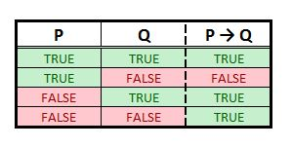
Proving validity
Let’s revisit our argument:
“If student submits his homework, then he will get a grade. Student submitted his homework. Therefore, student will get a grade.”
Let’s add the truth table:

Slide 30
Proving validity
Remember: An argument is valid - the conclusion MUST BE TRUE, if the premises are TRUE.
conclusion
VALID
premises

Slide 31
Rules of inference
Rule of inference - logical form consisting of a function which takes premises, analyzes their syntax, and returns a conclusion.
We will mention only few:
Modus ponens – the law of detachment
Modus tollens – the law of contrapositive
Hypothetical syllogism – chain argument

Slide 32
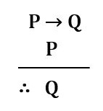
Modus ponens
A method of affirming.
Example:
“If it is raining, I am staying at home.”
“It is raining.”
“Therefore, I am staying at home.”

Slide 33
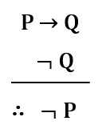
Modus tollens
A method of denying.
Example:
“If I am happy, then I am smiling.”
“I am not smiling.”
“Therefore, I am not happy.”

Slide 34
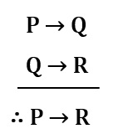
Hypothetical syllogism
A chain argument.
Example:
“If I study, I will pass Analysis 1”
“If I pass Analysis 1, I will be happy.”
“If I study, I will be happy.”

Slide 35

Exercise 2
Determine if the following argument is valid?

Slide 36
Exercise 3
Use truth tables to prove if the following arguments are valid:
A) If it is raining, then there are clouds in the sky.
It is raining.
Therefore, there are clouds in the sky.
B) If it is raining, then there are clouds in the sky.
There are clouds in the sky.
Therefore, it is raining.
Notes:
Note (Answers):
The argument A is valid (it is actually modus ponens).
The argument B is NOT valid. It means that if there are clouds in the sky, we cannot determine that it is raining.

Slide 37
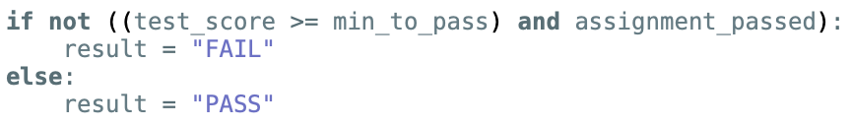
Exercise 4
Simplyfy the following if statement:
There are 2 solutions. Try to solve it on your own, and then check the file week41.py.

Slide 38
Summary Quiz
What is the importance of De Morgan’s Laws (where do we use them)?
What is deductive reasoning in logic?
What is required in deductive reasoning to have a truthful conclusion?
What is tautology?
What is contradiction?
What is contingency?
When is an argument valid?
When is an argument sound?
How can we prove validity of an argument?
Name three rules of inference covered in this lesson.

Slide 39
Summary
De Morgan's Laws describe how mathematical statements and concepts are related through their opposites. In propositional logic, De Morgan's Laws relate conjunctions and disjunctions of propositions through negation.
Deductive reasoning is a top-down logic approach, that links premises with conclusions. It is the process of reasoning from one or more statements to reach a logically certain conclusion.
To reach a truthful conclusion in deductive reasoning, all premises must be true, terms clear, and rules of deductive logic followed.
Tautology is a formula or assertion that is true in every possible interpretation.
Contradiction is an unsatisfiable statement, both through negation or affirmation.
Contingency is a formula that is neither Tautology nor Contradiction.

Slide 40
Summary
An argument is valid, if it is impossible for its premises to be true, while its conclusion is false (the conclusion must be true, if the premises are true).
An argument is sound if it is valid and the premises are actually true.
Validity can be proven using truth tables.
In this course we showed three rules of inference: 1) modus ponens (the law of detachment), 2) modus Tollens (the law of contrapositive) and 3) hypothetical syllogism (chain argument).

Slide 41
Extra material - videos
Disclaimer:
The following videos are not part of the course material, and as such, are treated as an extra information. The teaching team believes it is beneficial to the students to also have the topics presented from a different perspective. Some video will provide more information that given at the lesson, some less.
For the exam, the only relevant information is considered the one given by the teachers and written in the course book.
To understand the topics better, using external sources, like the videos given below, is strongly recommended. Feel free to explore, and ask your teacher should you have any questions.

Slide 42
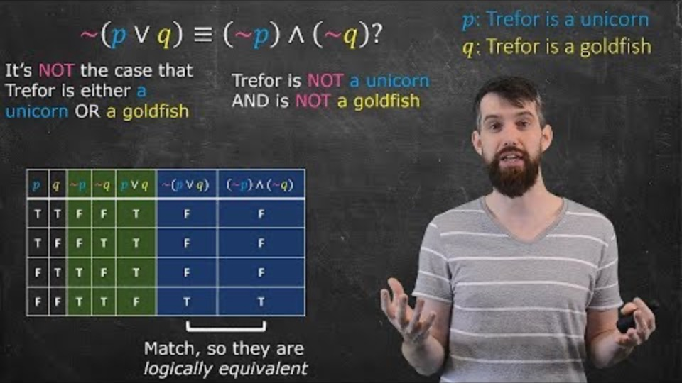
Logical equivalence and De Morgan’s Laws
Notes:
URL:
https://www.youtube.com/watch?v=93CxSLi89Ok

Slide 43
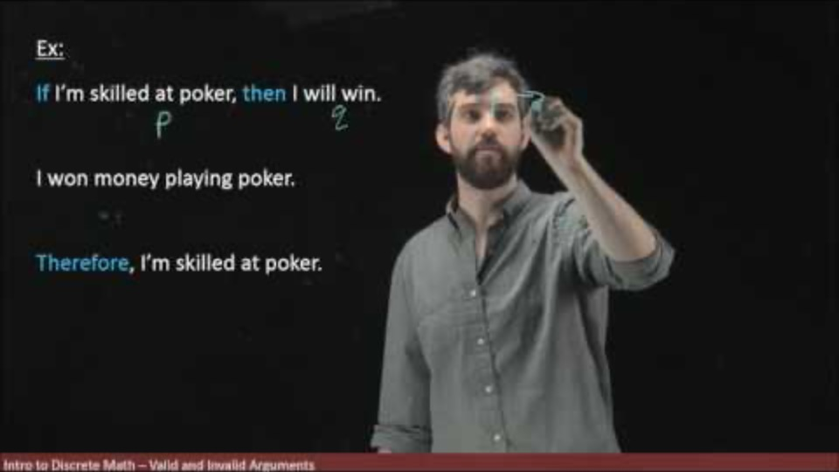
Validity
Notes:
URL:
https://www.youtube.com/watch?v=ON7yAw6W9VY

Slide 44
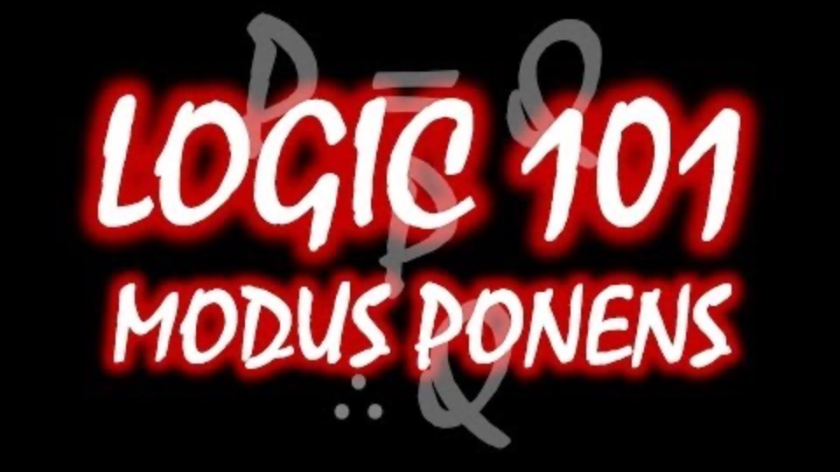
Modus ponens
Notes:
URL:
https://www.youtube.com/watch?v=JhH9i47YFHQ

Slide 45
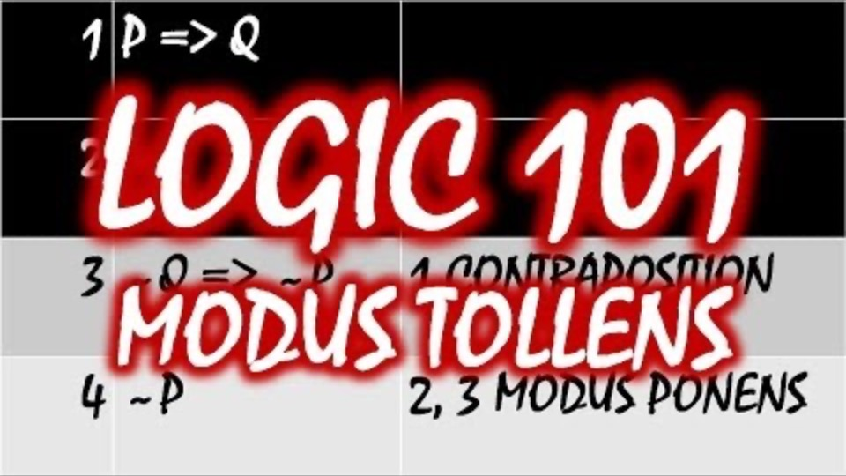
Modus tollens
Notes:
URL:
https://www.youtube.com/watch?v=6qsEDFNDm5s

Slide 46
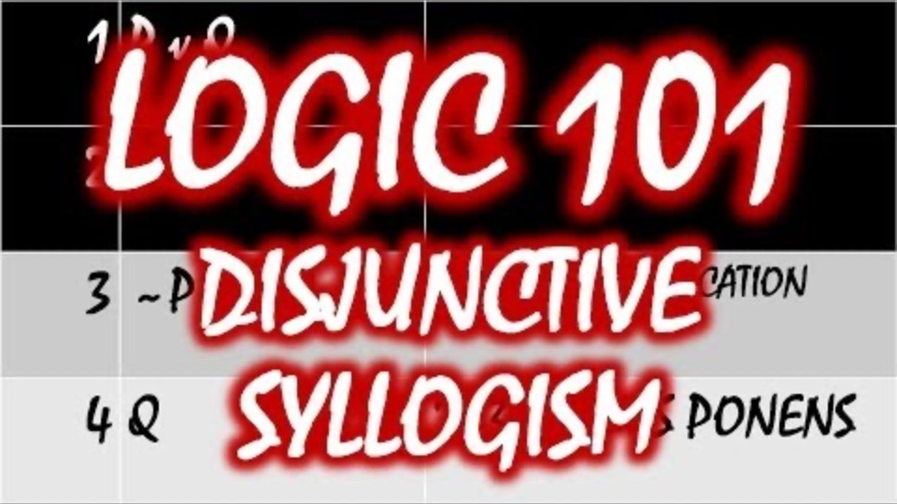
Disjunctive syllogism
Notes:
URL:
https://www.youtube.com/watch?v=0VqRy2o3A6U

Slide 47
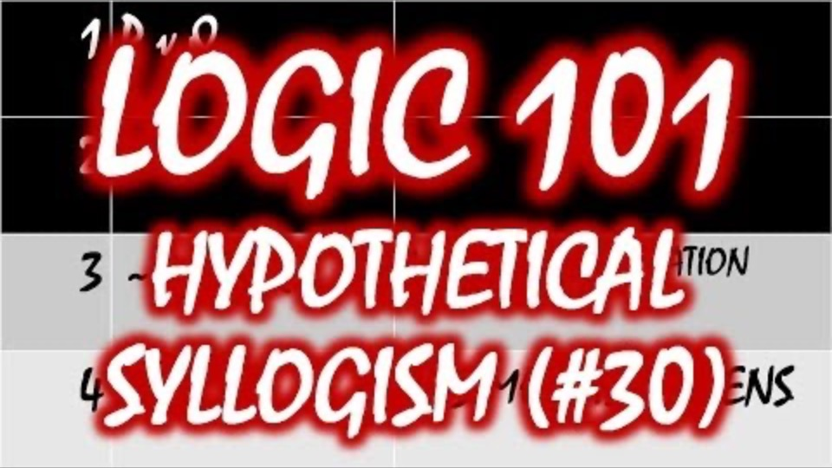
Hypothetical syllogism
Notes:
URL:
https://www.youtube.com/watch?v=VA9xFYAjNq4

